Slide 1
Taping OAI
Ultimate KNOW-HOW Of…
By Zulhisham Tan – S1609
3rd November 2011

Slide 2
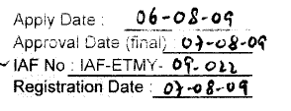
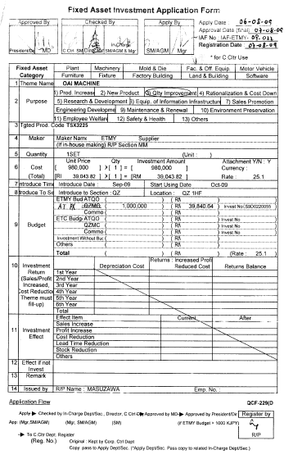
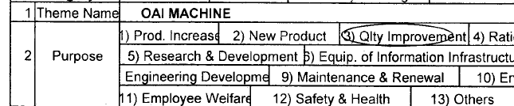
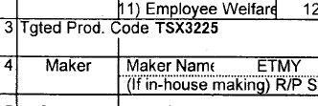
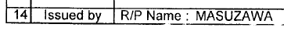
Investment Proposal

Slide 3
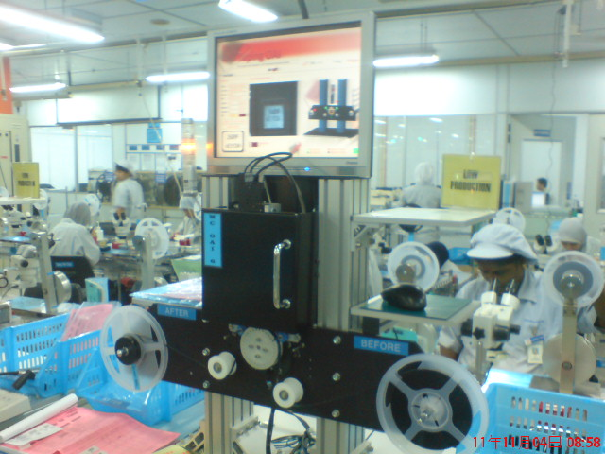
Investment Proposal
Not Operating !
Machine Minor Stoppages
Output Could Not Achieve
DR2 Not Completed!

Slide 4
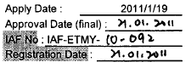
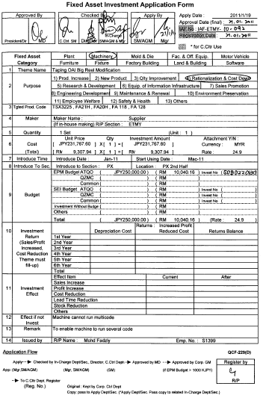
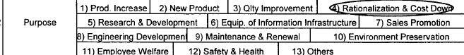
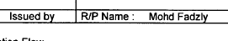
Investment Proposal
RM270k Total of 6 machines
Worker reduction by >50%

Slide 5
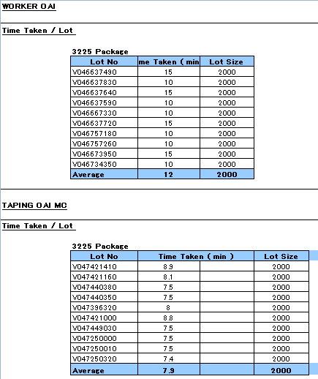
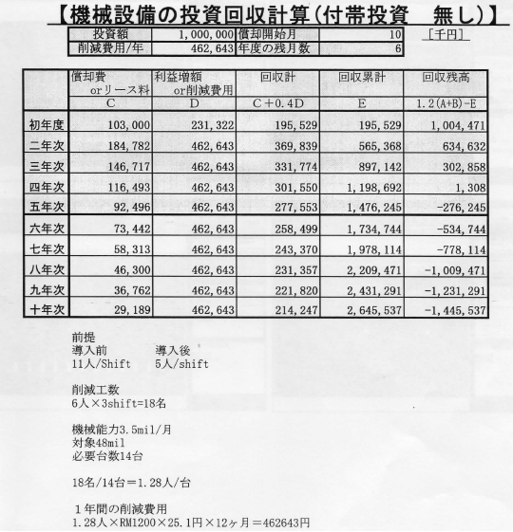
Main Objective
!
The ROI Simulation is based on TSX Package
Worker Reduction

Slide 6
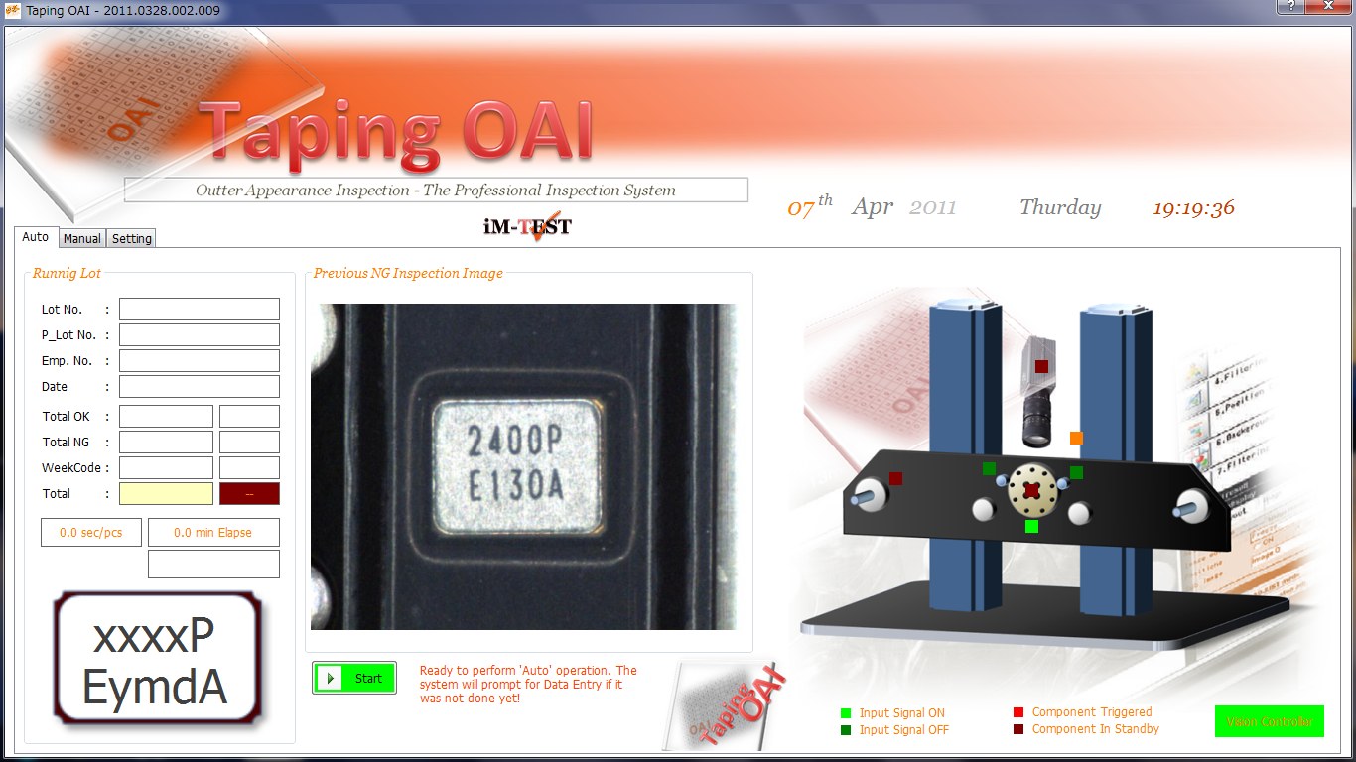
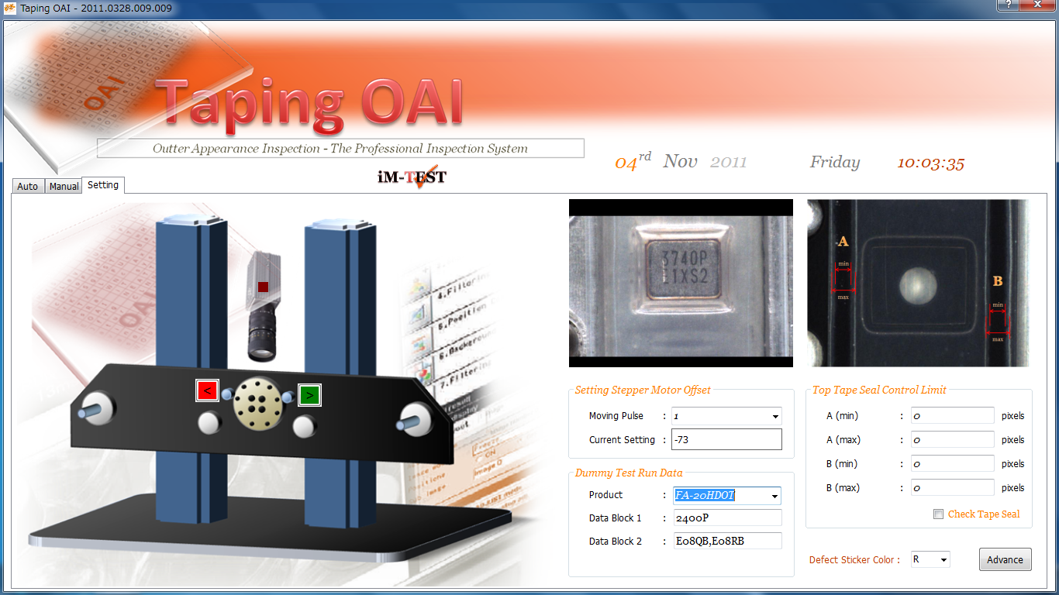
Basic Requirement Of OAI
OAI Defect : Dirty, Scratch, Marking Defect
Frequency Mixing
Week Code Mixing
Multi Code
Sealing Inspection
Support Jumbo Rail
Week Code Jumping
Top Tape Broken
Double Pieces
Worker Reduction

Slide 7
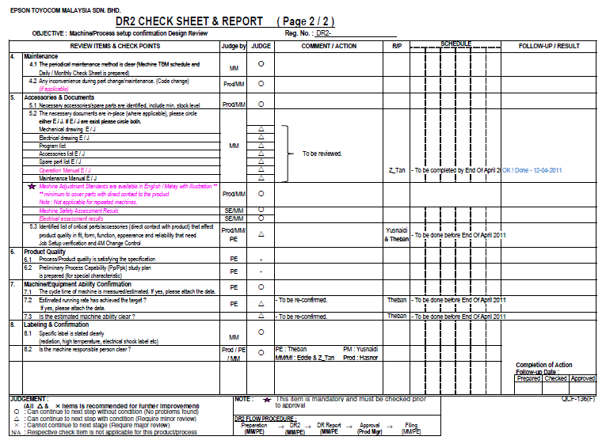
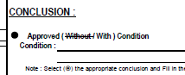
Development Achievement
Machine Minor Stoppages
Output Could Not Achieve
DR2 Done but Some item pending
Case Study :
P
Operating Time
P
Minor Stoppages
P
Mixing
P
Accuracy

Slide 8
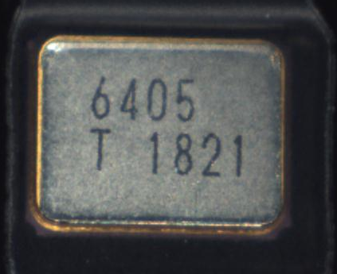
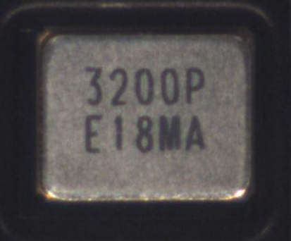
Case Study 1 : Operating Time
TSX-3225
FA-20H
0 ~ 9 = 10
0 ~ 9 + P = 11
21
47
0 ~ 9 + T = 11
0 ~ 9 ; A~ Z = 36
50% Up
OCR Inspection Time
P
The number of Character to be inspected.
P
The quantity of Sample to be recognized.

Slide 9
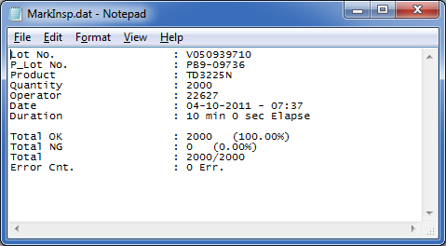
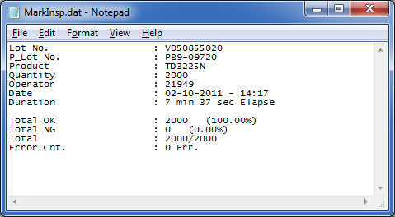
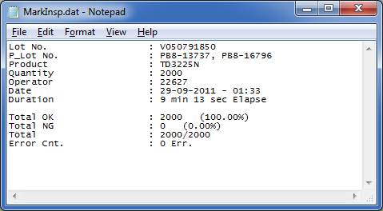
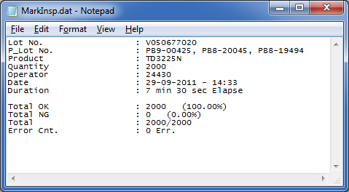
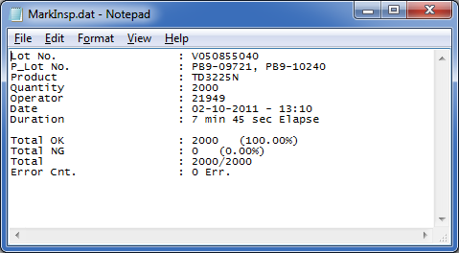
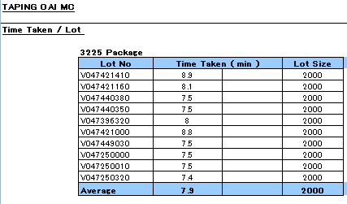
Case Study 1 : Operating Time
TSX-3225
<0.25sec/pcs
Target Achieve!

Slide 10
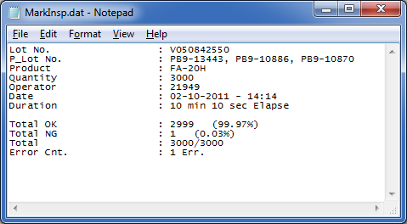




Case Study 1 : Operating Time
FA-20H
Operation Time & Minor Stoppages Increase
<0.25sec/pcs
>30% Up
Operating Time

Slide 11
Case Study 1 : Operating Time
<0.25sec/pcs
TSX-3225
FA-20H
Calculate as per Lot not per Piece
Machine Running Rate
P
The number of Character to be inspected.
P
The quantity of Sample to be recognized.
P
Quantity per Lot
P
Quantity of Minor Stoppages

Slide 12
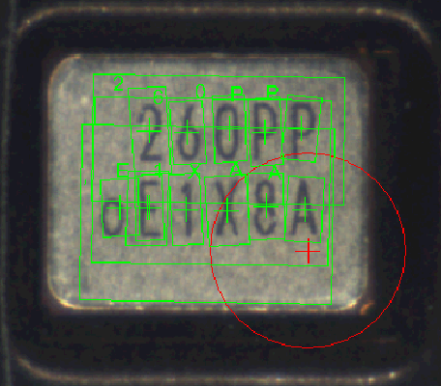
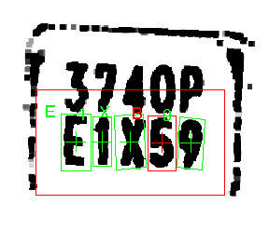
Case Study 2 : Accuracy (Mixing)
Week Code No Record!
Q = 0
A = 4,8
K = R
H = N
S = 8
Wrong Judgment
B = 8,5,E
T = 1
Incoming Material & Marking Condition
R = N
E = F,B
Resolution of the Camera & and the Vision Controller

Slide 13
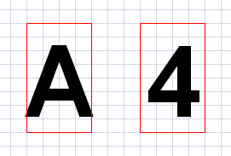
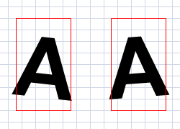
Case Study 2 : Accuracy (Mixing)
Wrong Judgment!
Practical
Statistical Calculation were use to examine the population of the region of interest.
The size of the character
The thickness of line
The rotation angle
Broken image

Slide 14
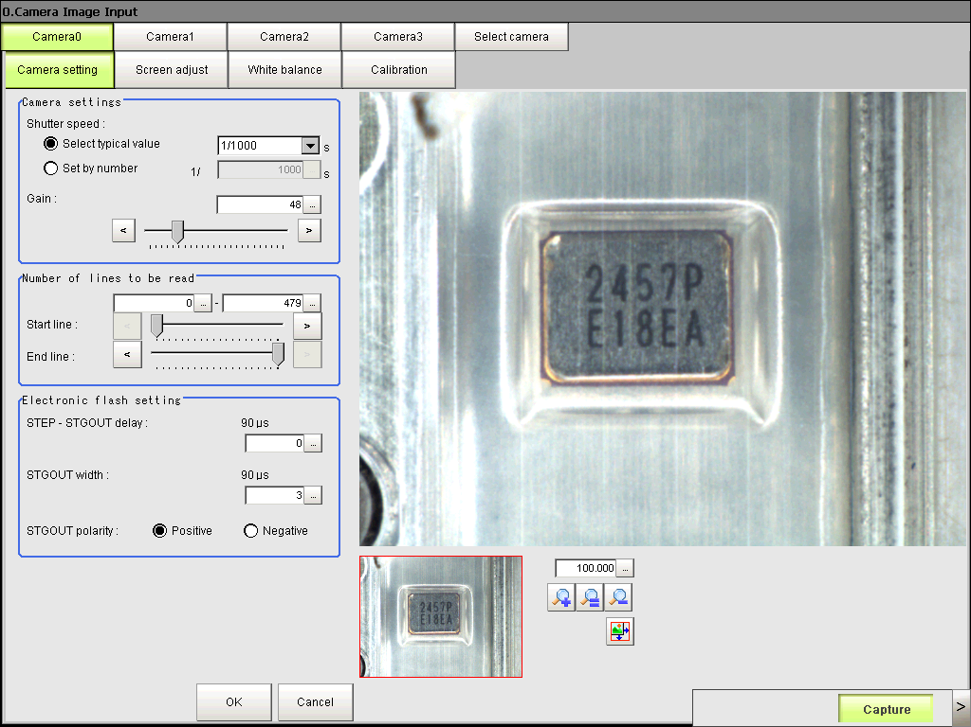
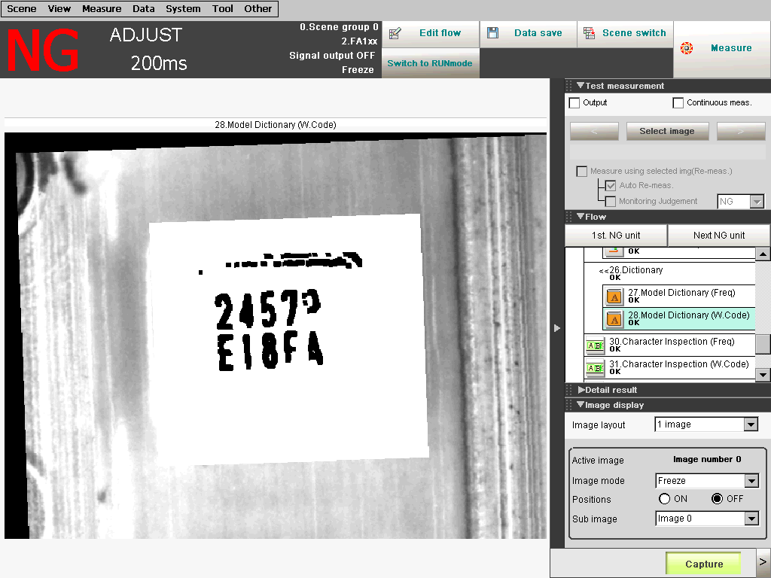
Case Study 3 : Minor Stoppages
Top Tape Scratch
Top Tape Dirty
Image Processing
Distorted image cause machine stop
Wrong Judgment as ‘F’

Slide 15
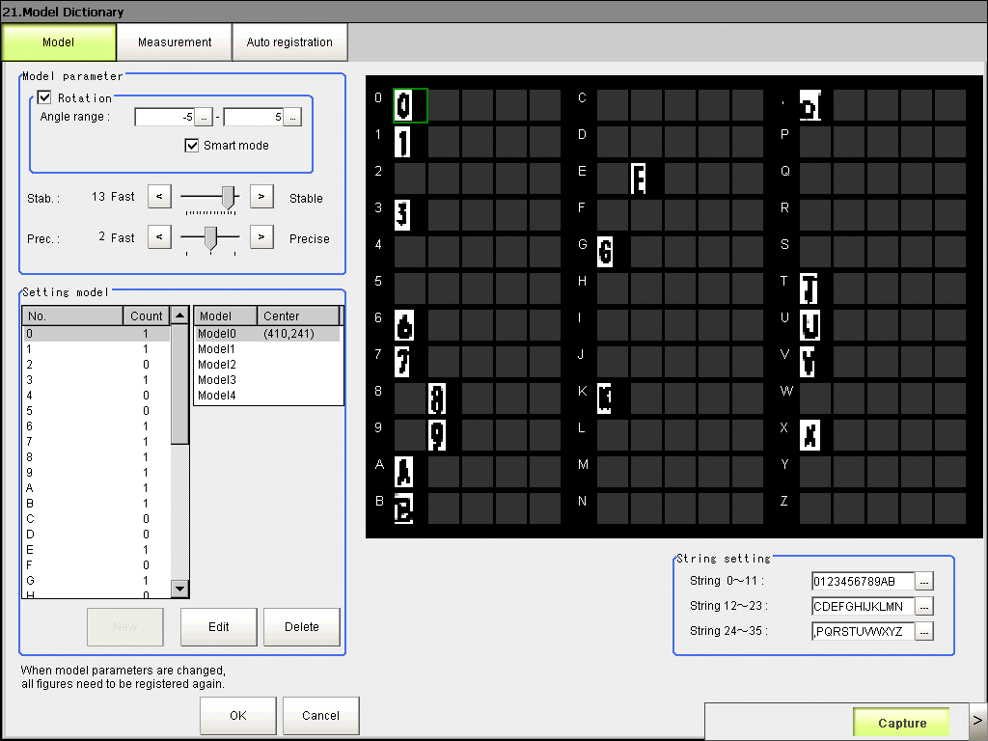
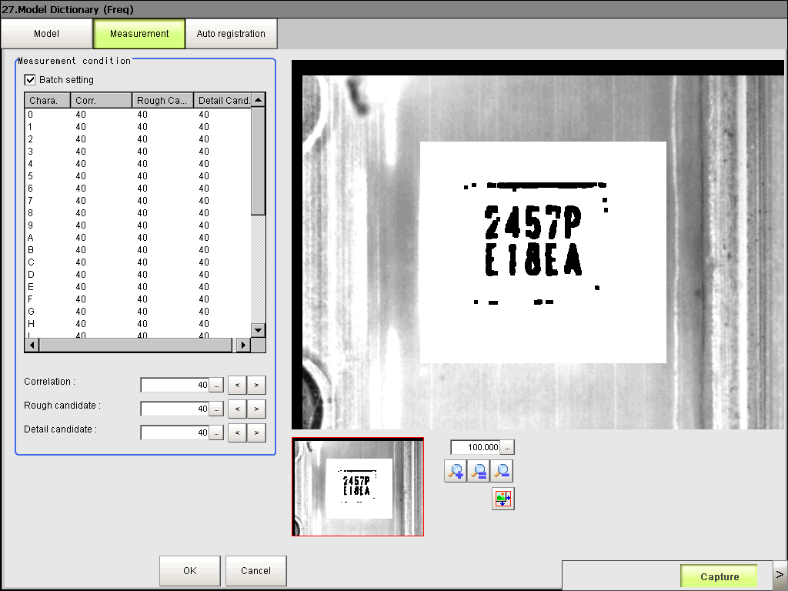
Case Study 4 : Accuracy Increase
Pattern Library must fully registered
Increase Inspection Time
Control level of ‘GO/No GO’

Slide 16
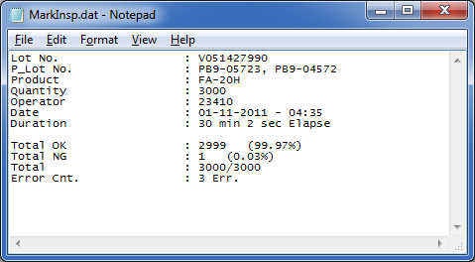
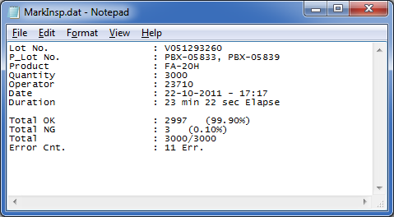
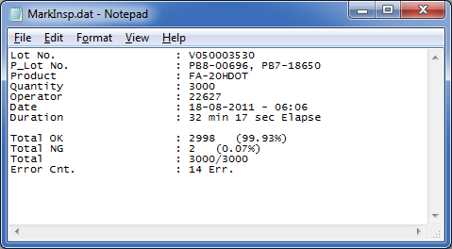
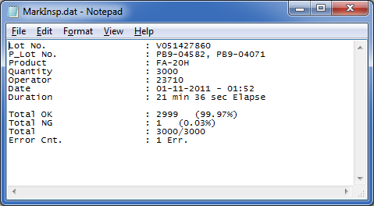

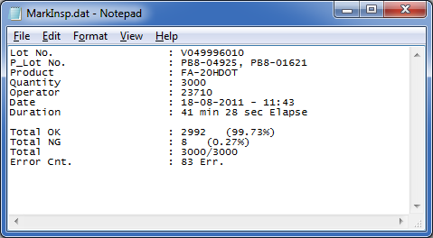
Case Study 4 : Accuracy Increase
Better Accuracy
Increase Operation Time & Minor Stoppages
Production Output Interruption
Average 40mins/Lot

Slide 17
Case Study Summarization
Machine Running Rate
P
Production Output
The number of Character to be inspected.
P
The quantity of Sample to be recognized.
P
Quantity per Lot
P
Quantity of Minor Stoppages
P
Increase Judgment Accuracy
Minor Stoppages & Opt. Time
Target Achieve

Slide 18


Conclusion : Main Constraint
!
Minor Stoppages, Opt. Time & M/C Accuracy
Increase Sys. Accuracy
Worker Reduction
Further R&D – Continuous Improvement

Slide 19
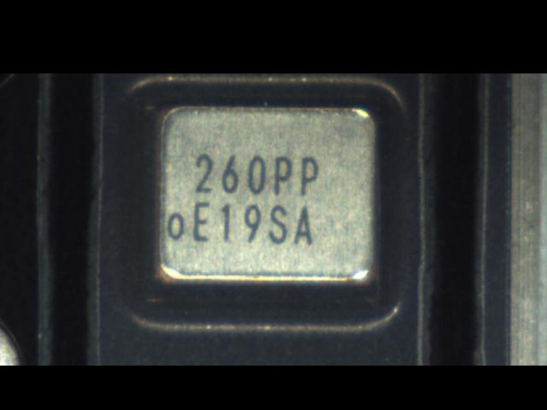
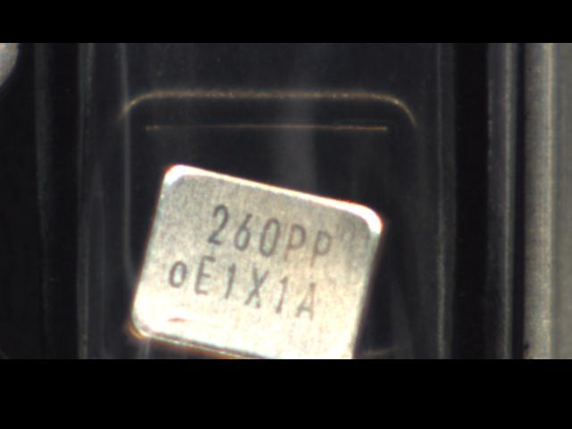
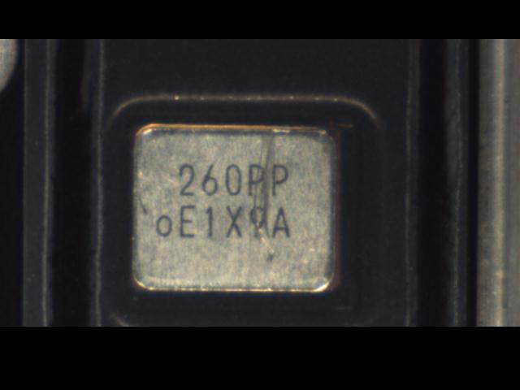
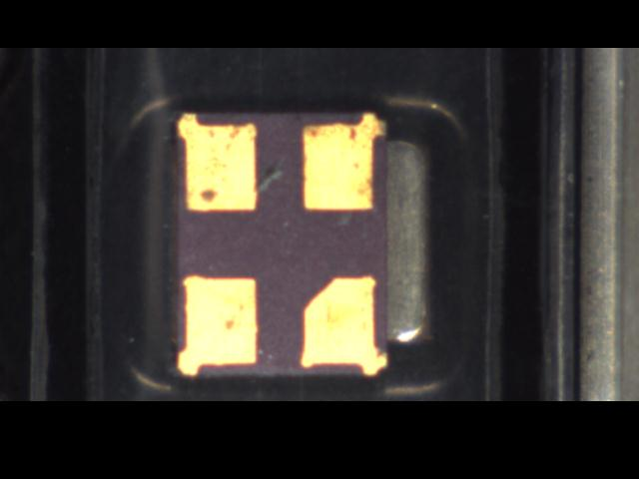
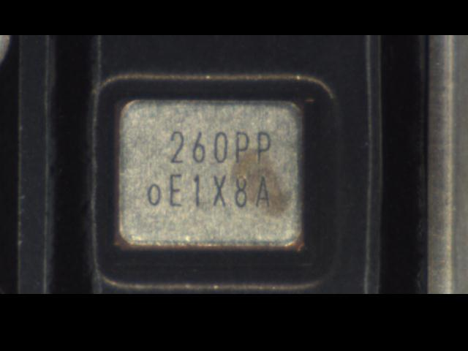
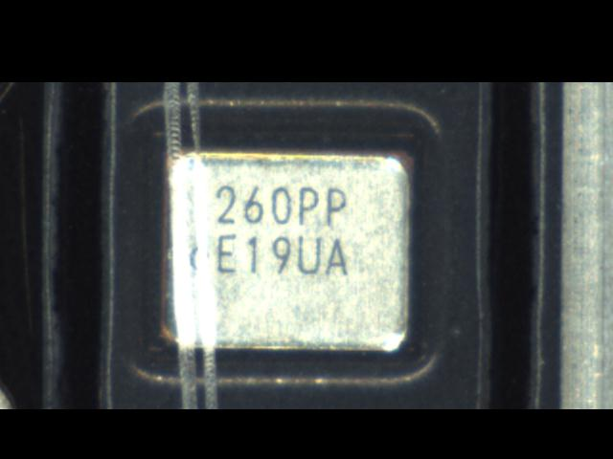
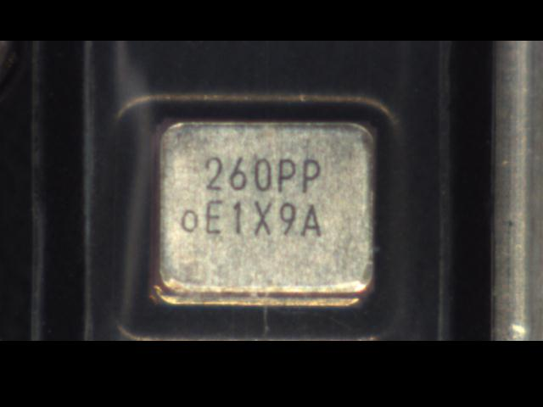
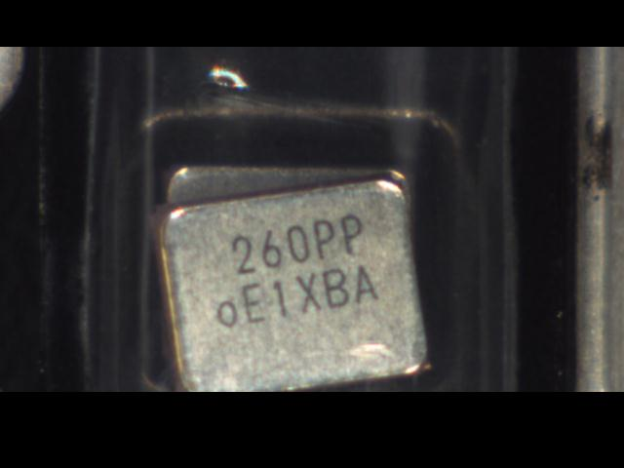
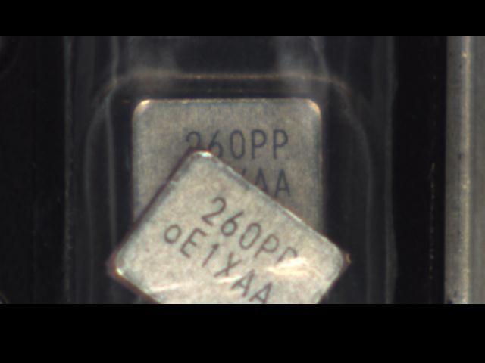
Overall Achievement
P
OAI Defect : Dirty, Scratch, Marking Defect
P
Frequency Mixing
P
Week Code Mixing
P
Multi Code
P
Sealing Inspection
P
Support Jumbo Rail
P
Week Code Jumping
P
Top Tape Broken
P
Double Pieces

Slide 20
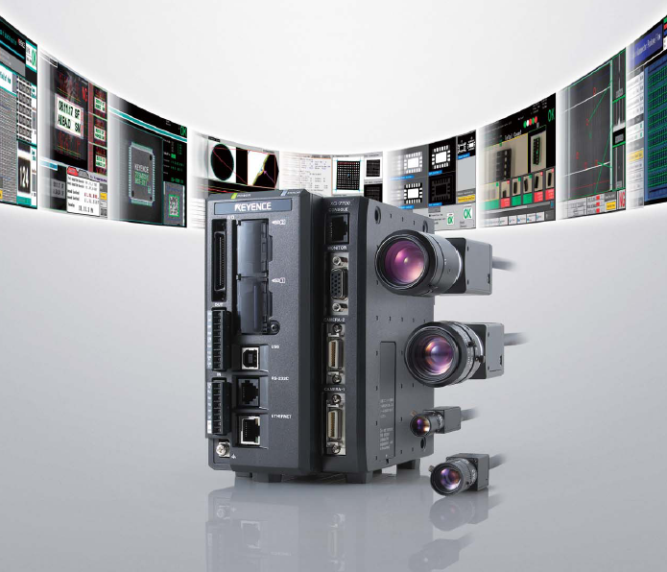


Continuous Improvement
P
More Flexible & Power
P
Higher Level of Control
P
Higher Accuracy
Loan Evaluation Unit Until End Dec ‘2011

Slide 21
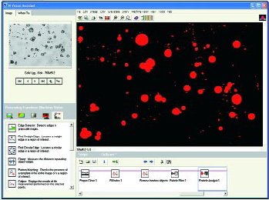
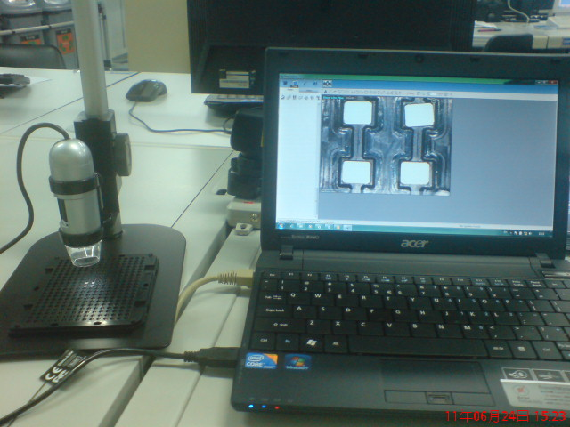



Continuous Improvement
To achieve full software control
Integrate with third party software library to do judgment.
Digital Microscope
Generate Traceable Digital Data

Slide 22
Fundamental OAI Requirement
Objective !
To reduce Taping OAI workmanship by 50% with
Review Taping OAI Standard
Implement Taping OAI machine using new Judgment standard
New OAI Judgment Standard
Objective is to detect Sealing Defect (by worker).
To detect Tape Broken (by worker).
To detect Mixing (by machine) – Check Freq. & CL only.
P
Target
Machine Cycle Time : < 0.2 sec
P
6 Machines Ability : 55 mil
YES!
P
Confirming Rate : 99%
P
Running Rate : 90%
P
Machine Availability : 29 days; 21.75 hrs

Slide 23

Conclusion
P
New OAI Judgment Standard
Objective is to detect Mixing (by m/c)
– Check Freq. & CL only.
To be completed before End of November ‘2011

Slide 24
Current Status Of Worker Reduction
From 10 worker per shift reduce to 5 worker per shift
To be completed before End of November ‘2011

Slide 25
Return On Investment
Total Investment
= RM45k x 6 m/c
= RM270k
ROI
Present Stage
(1.5 worker / group Reduction)
Worker Reduction
= 1.5 Worker x 3 group
= 4.5
Cost Saving
= 4.5 Worker x RM2k
= RM9k
= 30 months
ROI
= RM270k/RM9k
ROI
Next Stage
(5 worker / group Reduction)
Worker Reduction
= 5 Worker x 3 group
= 15
Cost Saving
= 15 Worker x RM2k
= RM30k
= 9 months
ROI
= RM270k/RM30k

Slide 26



Support : Provide Traceability Data
Taping Lot No.
Database
Mother Lot No.
IMI No.
Week Code
Machinery Network : Traceability Data
Web based Application

Slide 27


Proposal
100% Marking Inspection at Taping Machine
A breakthrough Activity at SD section

Slide 28
Proposal : Objective &To Do
To Support part of the OAI function
Marking Inspection is more accurate without the Top Tape since image is easier to process.
Merits
Network Connected.
Cycle time remain unchanged since measurement time longer.
Budget RM2000/machine By ETMY
Able to detect week code jumping (testimony from SD).
No additional operation.
To Do…
Software Construction (PC & PLC)
Electrical Wiring Modification

Slide 29

Collaboration Of Hitting The Target
10 U! ☺

